Slide 1

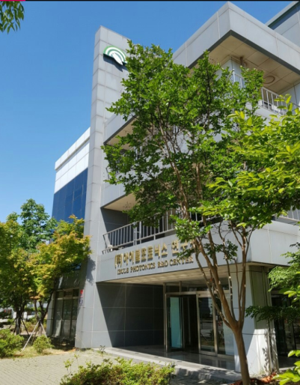
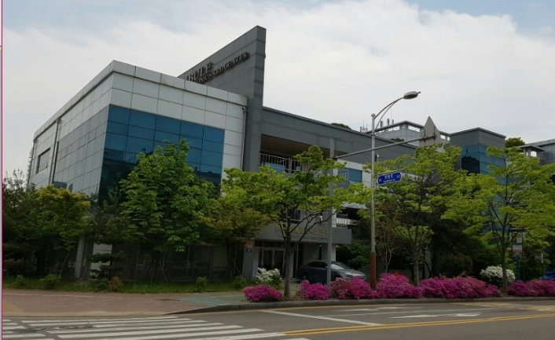
SC MEMS
MEMS APPLICATIONS
드론/레이저 무기제어용
MEMS Mirror 구동기
A world leader in the development of high performance piezoelectric single crystals MEMS applications.
22, Gaetbeol-ro 145Beon-gil,
Yeonsu-gu, Incheon(21999), Korea
Tel : 82-32-851-2908/2953
Fax : 82-32-851-2907
E-mail : sanggoo7@ibule.com
soisoi77@ibule.com

Slide 2
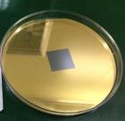
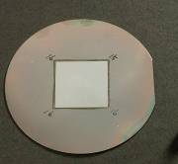
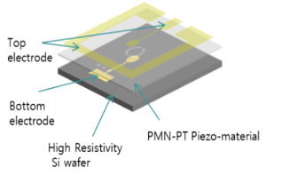
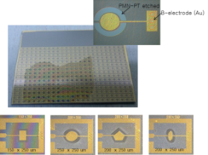
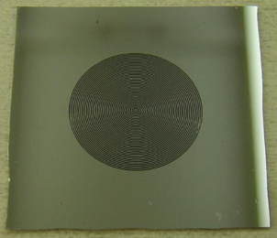
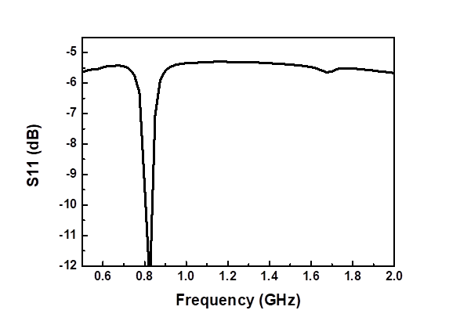
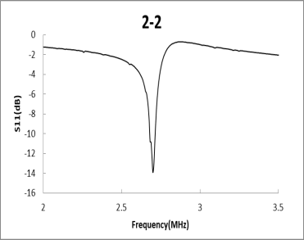


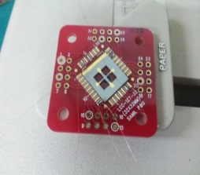
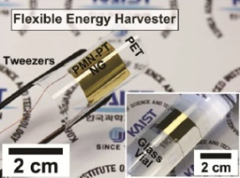
Film Piezo single crystal(FPSC) MEMS Applications
    SC MEMS, Inc. has process that can bond PMN-PT Single Crystal on silicone wafer and process it into thickness appropriate to application. Application is possible in products such as MEMS acoustic sensor or P-MUT (Piezoelectric micromachined ultrasonic transducers).
PMN-PT single crystal
Size : normal 20 * 20, max 40 * 40
Thickness : minimum about 5um
Electrode(option) : anything possible
A
A
epoxy
Si or SOI wafer
Electrode(option) : anything possible
    FPSC MEMS resonator
    FPSC MEMS deformable mirror
    0.8~1.5GHz resonance using [001] single crystal
    Wine-Glass mode resonators using [011] single crystal
    Wideband resonator
Single crystal PMN-PT block bonded on an SOI wafer (thickness 30um)
19 annular ring type actuators
17 mm diameter membrane
Large stroke over 10 um at 20 V for each actuator
High operating bandwidth up to 874 Hz
Ref. Journal of Microelectromechanical Systems, Volume: 20 , Issue: 6 , Dec. 2011
Actuator side
Mirror side
    FPSC MEMS accelerometer
    FPSC Energy Harvest : Nano-generator
The advantages of the use of piezoelectric.
    Flexible Single Crystalline PMN-PT Piezoelectric Energy Harvester
    Bending : Generation of high current signal of up to 0.223 mA and output voltage of 8.2 V
More controlled temperature dependence
No need for a stable driving source
Better long term stability
Higher possible band width
Ref. Advanced Materials, Volume 26, Issue 28, July 23, 2014
 | PZT | PMN-PT
Voltage sensitivity (mV/g) | 0.31 | 0.75
Charge sensitivity (pC/g) | 0.026 | 0.4
Resonance Freq. (kHz) | 11 | 10
Size (mm) | 10 x 10 | 10 x 11
Items | Specification
PMN-PT | Thickness : 8um
Mother substrate | Silicon wafer
Stressor | Ni film (Thickness : 20um)
Plastic substrate | Polyethylene terephthalate(PET)

Slide 3
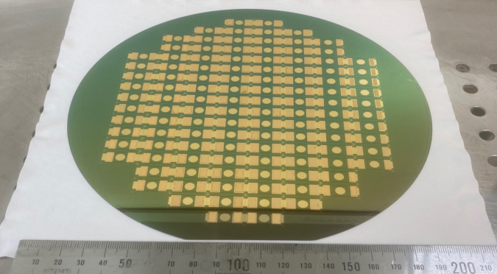
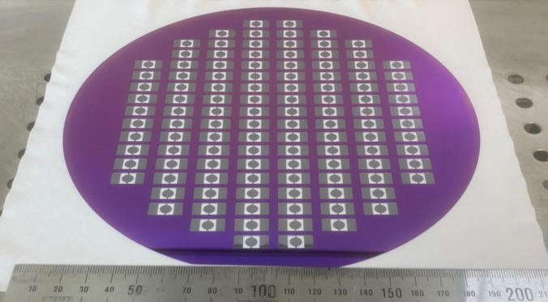
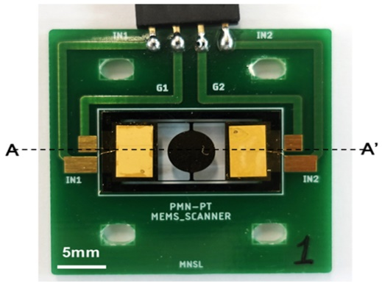
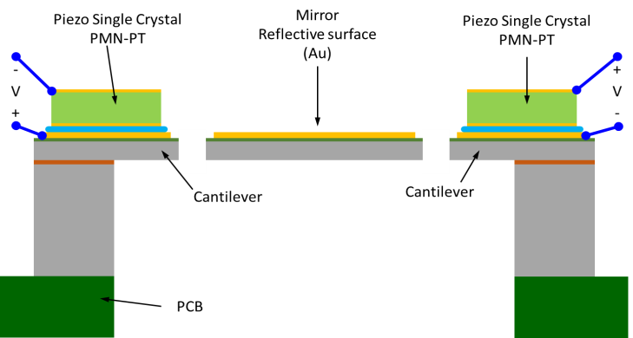
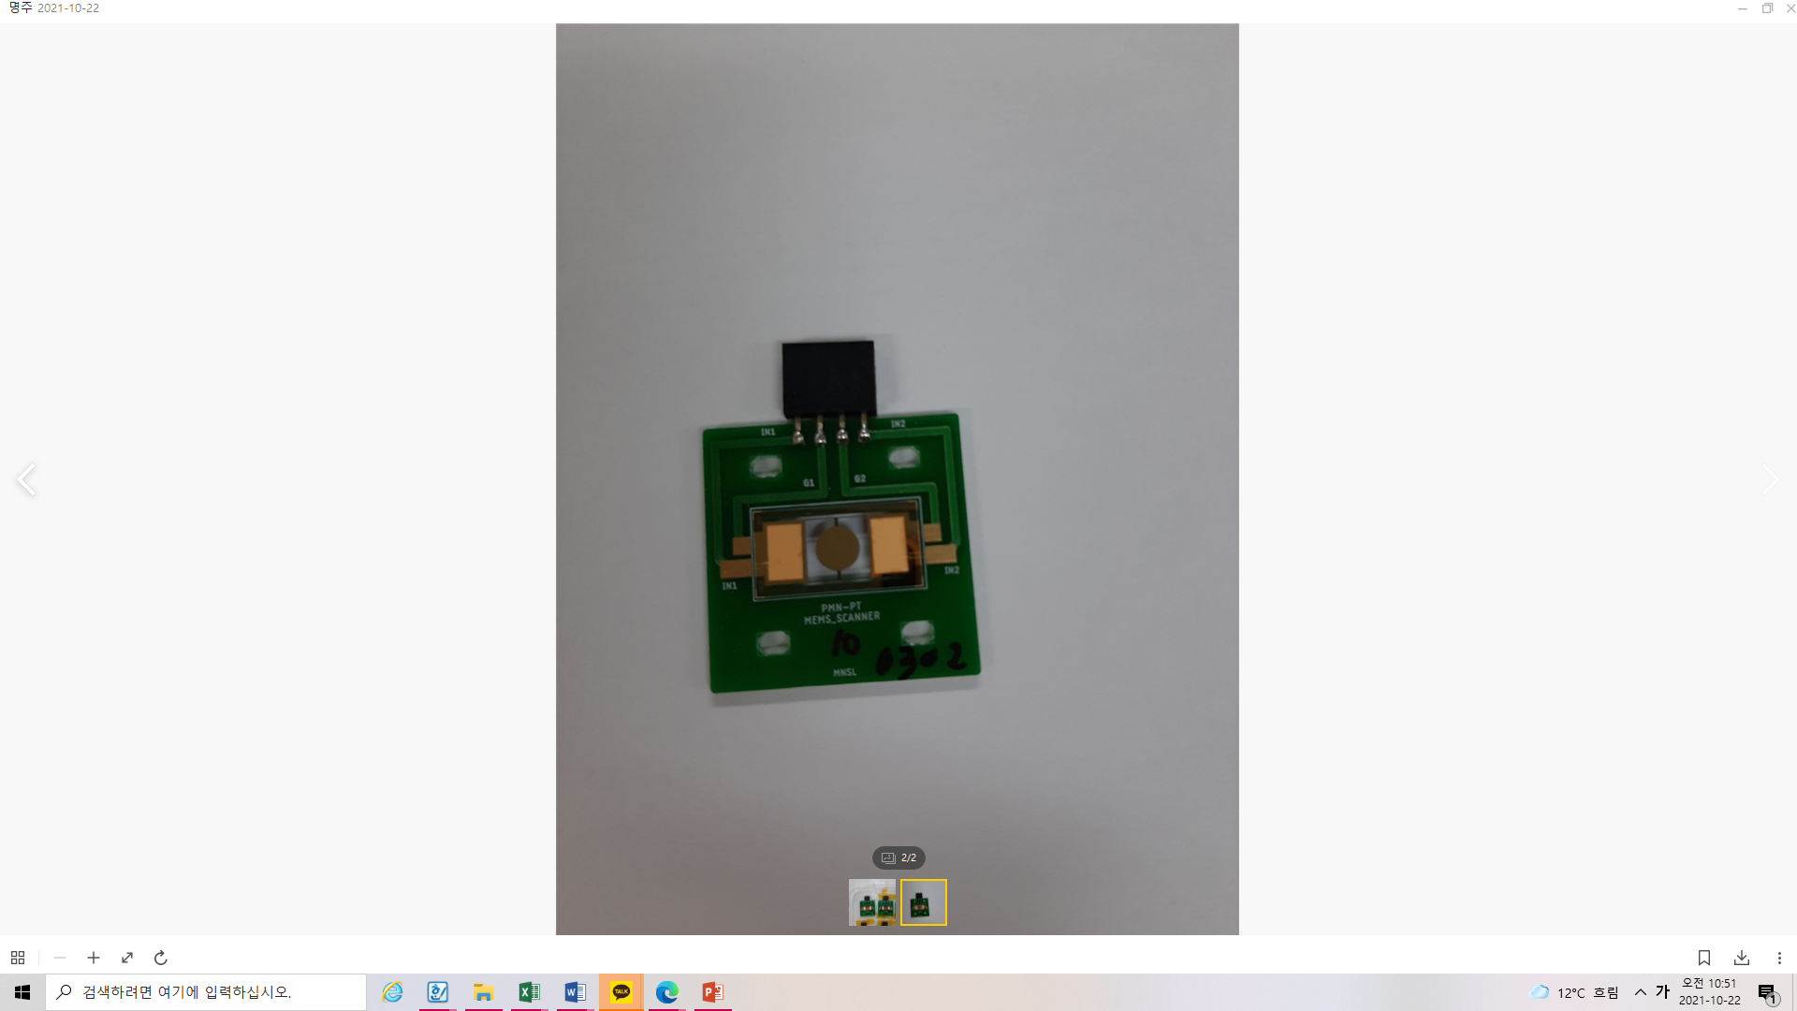
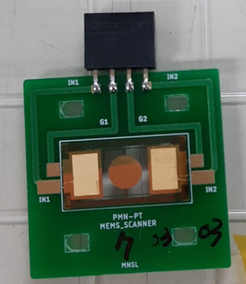
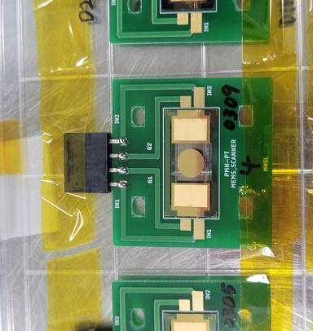
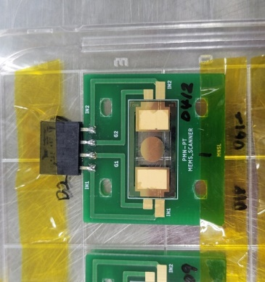
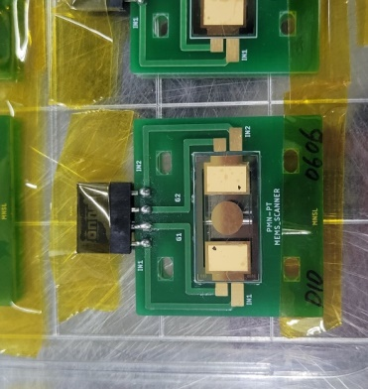
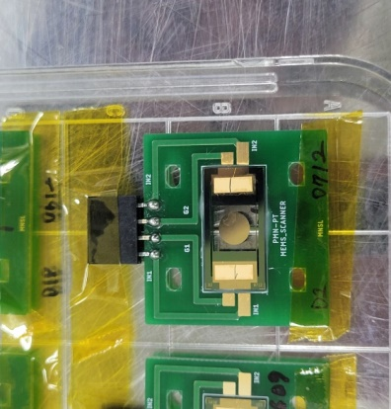
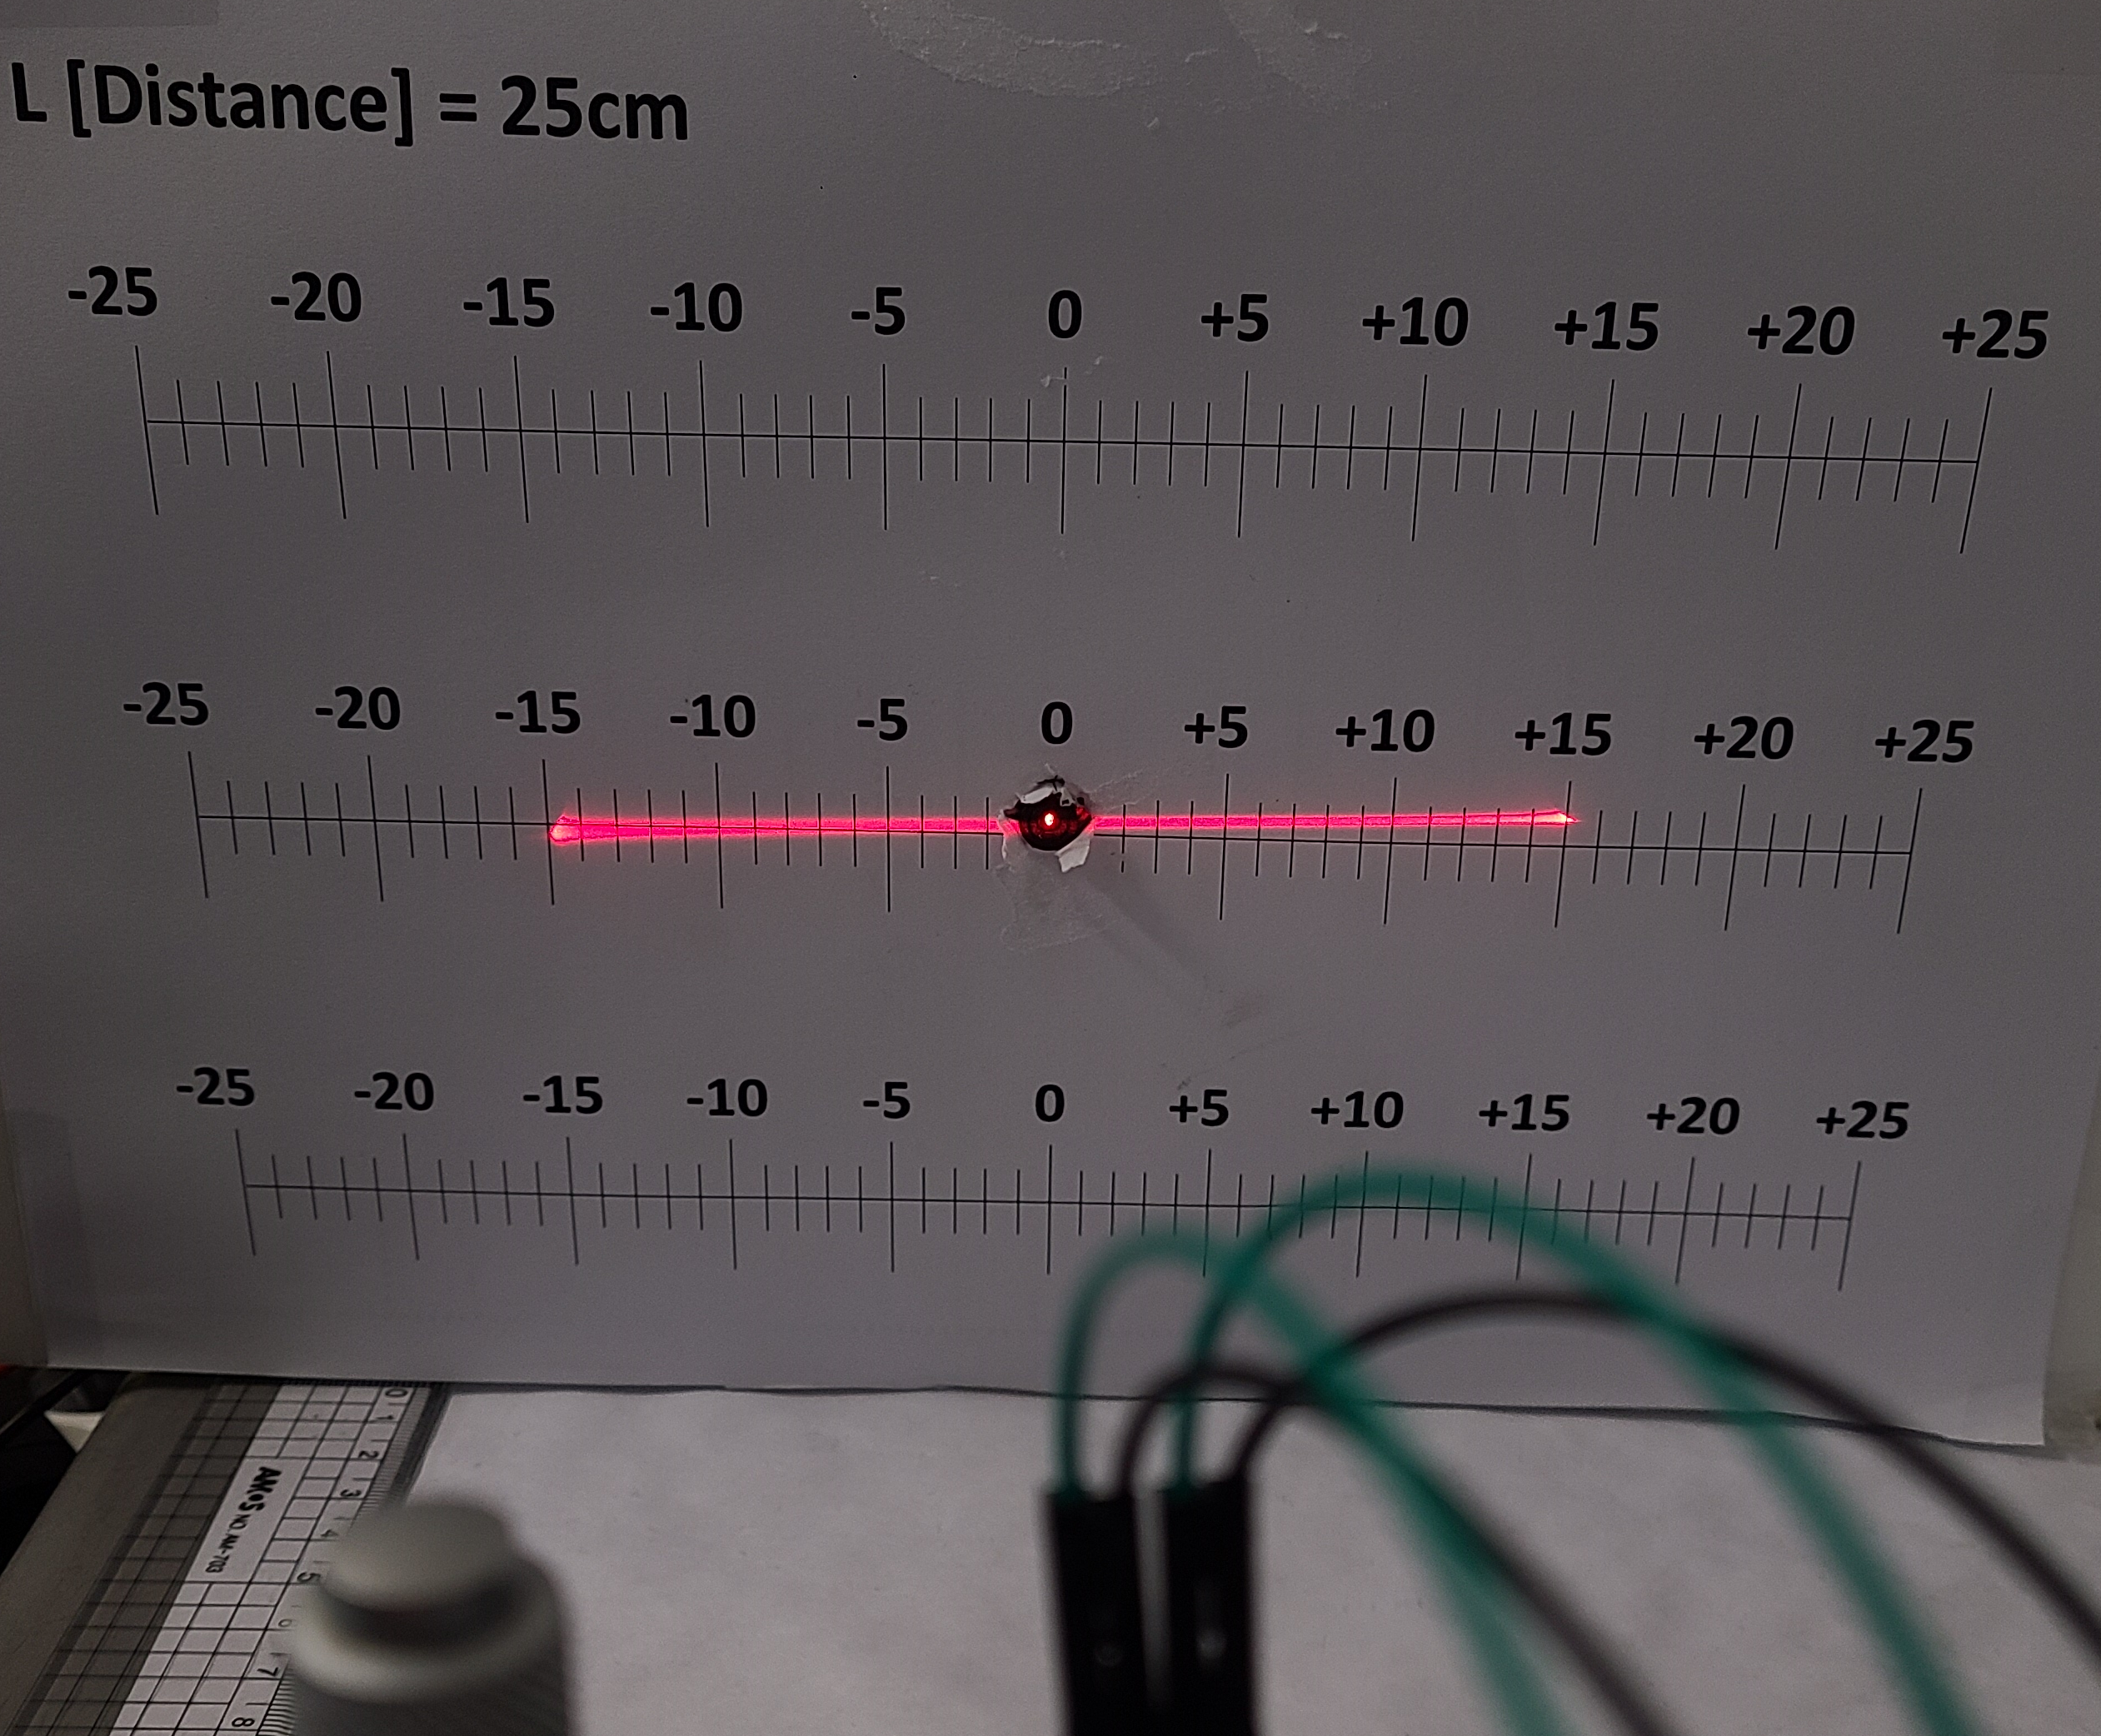
Film Piezo single crystal(FPSC) MEMS Lidar
    SC MEMS had successfully developed the Lidar sensor using Piezo Single Crystal PMN-PT actuator, and fabrication processing sizes up to 8 inch diameter.
No. 1
No. 2
No. 3
No. 4
No. 5
No. 6
Resonance Frequency [kHz] | 30° Drive Voltage [V_{pp}]
3.5 | 5.5
638nm
Laser Diode
PMN-PT
1D MEMS Scanner
PMN-PT 1
Out-of-phase
actuation
Function
Generator
PMN-PT 2
V_{IN} : IN₁, G₂
Ground : G₁, IN₂
Optical scan angle of 30°

Slide 4
Single Crystal Properties
PMN-PT
Parameter | Units | [001] poled |  | [011] poled
 |  | Low-PT | High-PT | Low-PT | High-PT
ε₃₃^{T}/ε_{o} | - | 4842 | 7000 | 3760 | 5770
d_{ij} | x 10⁻¹² C/N | d₃₃=1282 | d₃₃=1620 | d₃₂=-1140 | d₃₂=-1820
s_{ij}^{E} | x 10⁻¹² m²/N | s₃₃E=47 | s₃₃E=56 | s₂₂E=53 | s₂₂E=78
Trt | ºC | 95 | 85 | 95 | 85
Ec | KV/cm | 2 | 2.5 | 2 | 2.5
Density | Kg/m³ | 8080
PIN-PMN-PT
Parameter | Units | [001] Poled |  | [011] Poled
 |  | Low-PT | High-PT | Low-PT | High-PT
ε₃₃^{T}/ε_{o} | - | 4457 | 5666 | 3449 | 4656
d_{ij} | x 10⁻¹² C/N | d₃₃=1226 | d₃₃=1840 | d₃₂=-1323 | d₃₂=-1870
s_{ij}^{E} | x 10⁻¹² m²/N | s₃₃E=49 | s₃₃E=79 | s₂₂E=72 | s₂₂E=99
Trt | ºC | 120 | 90 | 120 | 90
Ec | KV/cm | 4 | 6 | 4 | 6
Density | kg/m³ | 8154
Unique piezocrystal properties create opportunities for unprecedented system performance.

